Slide 1
Predicting Best Neighborhood for New Business

Slide 2
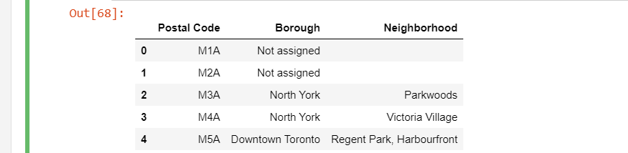
Downloading Data and Creating Dataframe
The data is collected from https://en.wikipedia.org/wiki/List_of_postal_codes_of_Canada:_M
With the help of BeautifulSoup data is retrieve.
Then data in stored in data frame called Toronto_df.

Slide 3
Data Cleaning
All unnecessary data are removed in this case Borough with Not assigned is removed.
If a cell has a borough but a Not assigned neighbourhood, then the neighbourhood will be the neighbourhood will be the same as that borough.

Slide 4
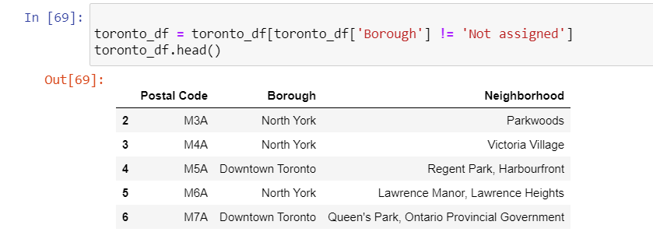
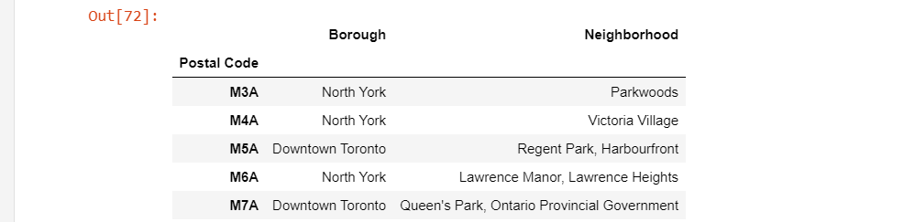

Slide 5
Methodology
For this report I used a few different maps that could help a new investor to decide the best neighborhood to open a restaurant in Toronto based on it's income, population and available competitors. In order to do that I've used the 2016 Census information combined with choropleth maps to visually display the wealthier and more populational neighborhoods and Foursquare data to display the current restaurants in each region.

Slide 6
Add Geospatial Data
The Geospatial data is retrieve from http://cocl.us/Geospatial_data.
We will the coordinates of the location i.e. latitude and longitude.
Then join it with the Toronto dataframe.

Slide 7
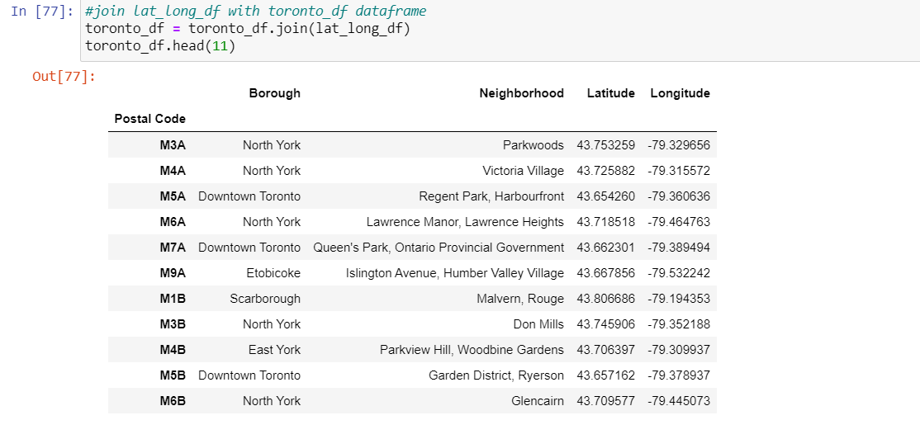

Slide 8
Generate Map
Map Generated using folium Map.
The credentials and versions are taken from Foursquare app.

Slide 9
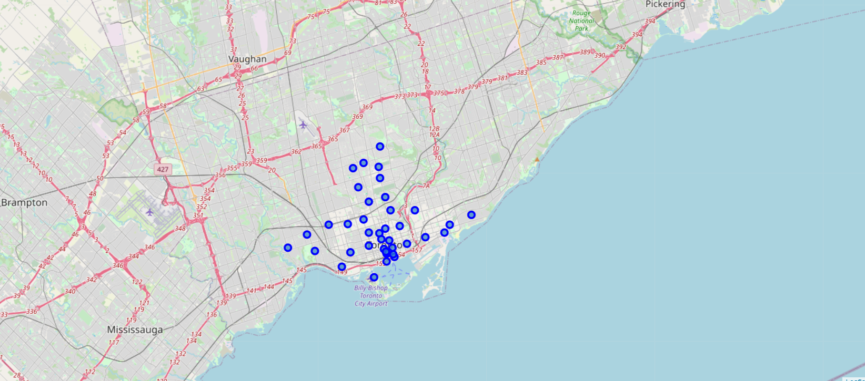

Slide 10
Result
Comparing the maps we can notice the majority of the restaurants grouped on main streets and on the south of the city, although some of the welthiest neighborhoods are up to the north. Also, the areas with a dense population don't reflect on the number of restaurants.

Slide 11
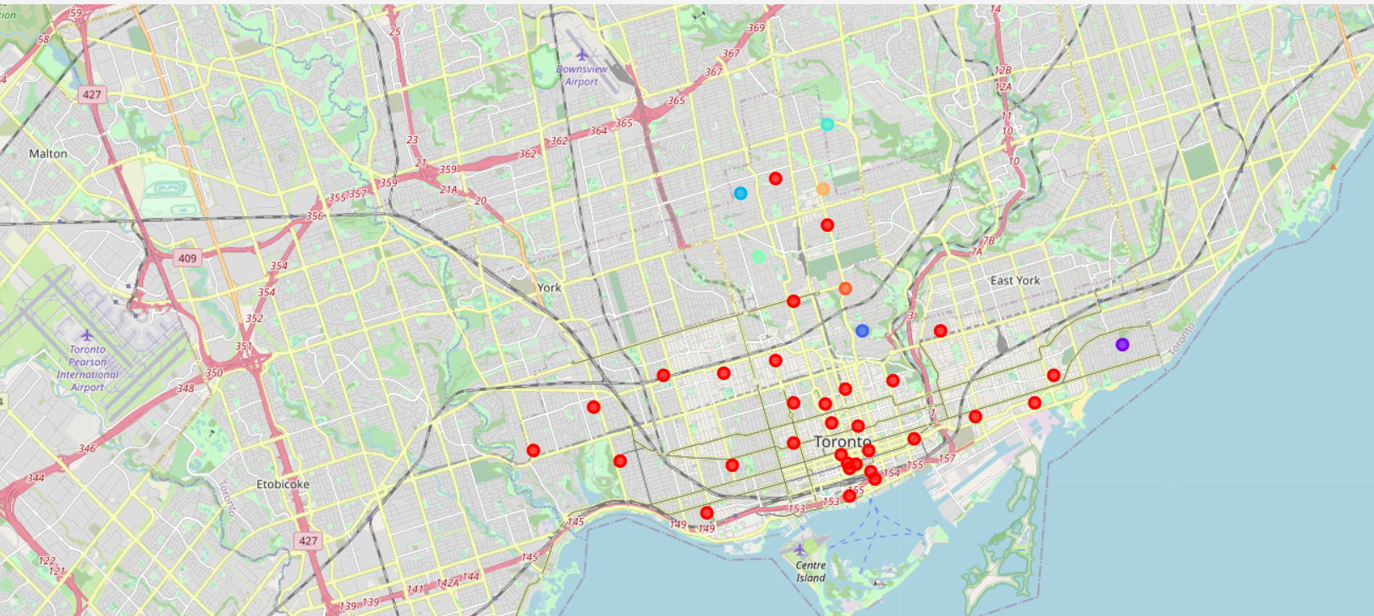

Slide 12
Conclusion
This report may be helpful for someone planning on opening a restaurant in Toronto, by comparing the current offers and neighborhoods profiles, however it may not cover all variables such as access to public transportation or even the restaurants profiles, so it shall not be used as a single decidion making tool.

